Slide 1
Container Technologies Foundation – Final Assessment
Jacques Adam

Slide 2
Agenda
Project summary
Architecture and manifests
Kubernetes resources added
How to run locally and in-cluster
Testing and scaling
Observalibility
Next steps and roadmap

Slide 3
Project summary
Django app (gallery) allowing user to upload images
Using PostgreSQL database and local image storage for persistence
Docker compose employed for initial image build and container development
Kubernetes manifests for cluster deployment (deployment, services, PVCs and secrets)
Note: as I am using Fedora Workstation 42 to complete the project, it is not possible for me to use Microsoft Powerpoint, I am therefore using LibreOffice for all Office-based artefacts

Slide 4
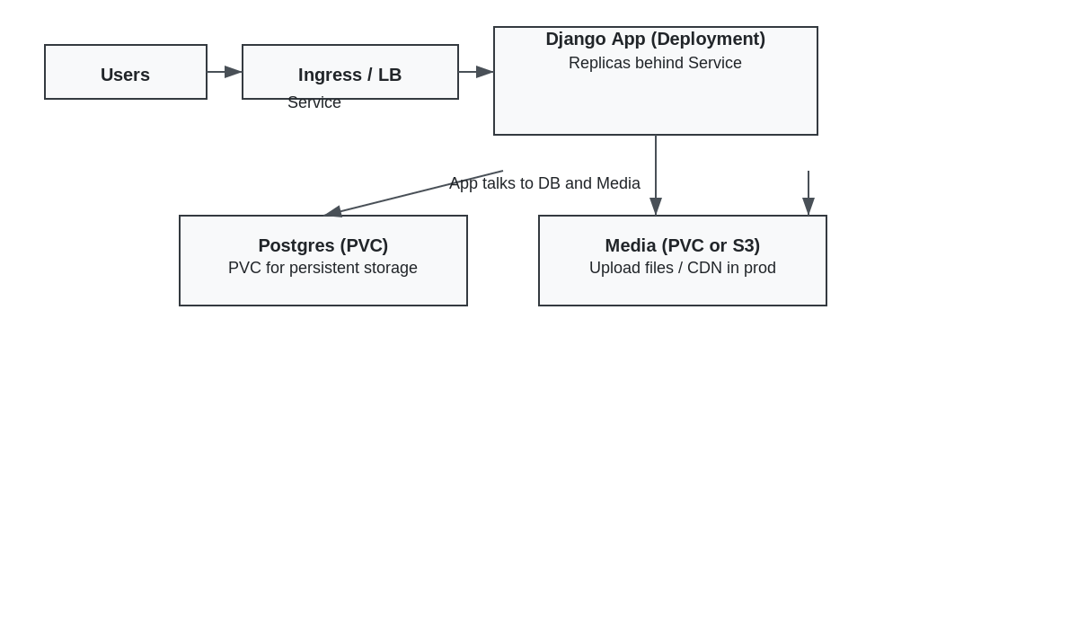
High-level architecture

Slide 5
Scaling with Kubernetes
Required the development of several manifests all stored under folder “k8s”
Secrets
Persistence Volume Claims for PostgreSQL and for the application
Deployments for PostgreSQL and for the application
Service manifests for both PostgreSQL and the application
Testing performed using the k6 load testing capability by Grafana. Test script k6-gallery-test.js saved in folder “k8s”

Slide 6
Kubernetes design choices
Postgres as a Deployment with PVC
Django Deployment uses an initContainer to wait for DB
ALLOWED_HOSTS driven by env var in settings

